Slide 1

Notes:
This should be the title slide for all corporate presentations pertaining to the overall university level

Slide 2

Faculty of Engineering and Technology
Department of Artificial Intelligence and Data Science
Notes:
This is the title slide for respective colleges/institutions while we retain the DMIHER logo on top always.

Slide 3

Presentation for Major Project-II

Slide 4
PRESENTATION FOR MAJOR PROJECT-II
TOPIC Budgeting and Expense Tracking System for Personal Finance Management
NAME OF STUDENT: SAHIL S. SHENDE
NAME OF THE SUPERVISOR: Ms. SHITAL HAJARE
DEPARTMENT OF ARTIFICIAL INTELLIGENCE AND DATA SCIENCE,
FACULTY OF ENGINEERING AND TECHNOLOGY, SAWANGI (MEGHE) , WARDHA
DATE : 28/02/2025

Slide 5
CONTENTS
Introduction
Prisma Chart
Prisma-S Extension
Knowledge /Research gap analysis
Knowledge/Research Gap Summary
Nature of the Knowledge Gap Identified
Research Question
Aim
Objectives
Methodology
Quarterly Scheduling of Research Work
Publication Schedule
References

Slide 6
INTRODUCTION
The fast-paced nature of modern life has made monitoring personal finances more challenging. Individuals face difficulties keeping track of income, expenses, and financial commitments
There’s a growing need for an intuitive, user-friendly application that simplifies financial management by offering tools to track expenses, set budgets, and achieve savings goals all in one place.
Addressing the difficulty of monitoring finances in today’s fast-paced world.
Designed to simplify expense tracking, budgeting, and financial planning.
Empower users to take control of their finances with an intuitive and efficient tool.

Slide 7
SYSTEMATIC REVIEW OF LITERATURE (PRISMA FLOW DIAGRAM)
Articles identified through other sources SCIE/SCOPUS/Research Gate Sources (n=12)
Articles identifies through IEEE searching (n=12)
Identification
Records after duplicates removal (n=20)
Records screened for removal(n=20)
Article excluded:(n=8)
Screening
Records excluded(n=2)
Full text articles excluded with reasons: Objective is not matching.
Number of Full text articles assessed for eligibility (n=12)
Eligibility
Original articles-3
Review articles-7
Number of Studies included in Qualitative and Quantitative (n=10)
Included

Slide 8
PRISMA-S EXTENSION
Topic | Item | Checklist item
Data base name | 1 | PubMed, IEEE, Elsevier, Research Gate, Google Scholar
Registries | 2 | N/A
MESH TERMS | 3 | Personal Finance Management, Digital Finance, Data-Driven Decision Making, User-Centered Design.
Search strategies | 4 | Mesh terms, Keywords, phrases, headlines, terms and citations are used as search strategies to collaborate the data
Selection process | 5 | Articles reporting on finance management, personal finance, expense tracker, budgeting and user experience.
Limits and restrictions | 6 | Prominence is given to the studies conducted within the 5 years. Studies before this period were used to describe the historical evidences.
Search filters | 7 | Studies not addressing the research question, incomplete abstracts, and studies with inadequate methodologies are filtered out.
Total records | 8 | Journal articles, Research articles. A total of 10 literature is the part of the study.

Slide 9
RESEARCH ARTICLES INCLUDED
Sr. No | Type of article | Total
1 | Original Article | 3
2 | SR & MA | 0
3 | RCT | 0
4 | Review | 7
5 | Books | 0
Grand Total | Grand Total | 10

Slide 10
KNOWLEDGE GAP
S. No. | Title of the Article Author Year of publication | Focus of Study, Design, Objectives , Method used and Sample size | Findings of the study and their conclusions | Remarks of the Scholar on limitations
1 | Agarwal, Visesh, Ravi Ray, and Nisha Varghese. "An AI-Powered Personal Finance Assistant: Enhancing Financial Literacy and Management.“ | The focus of the study is to develop an AI-powered personal finance assistant designed to address the challenges of personal financial management. These challenges include the complex financial landscape, lack of financial literacy, difficulties in tracking expenses, budgeting, and the inadequacies of existing tools, which often lack personalization and offer static budgeting and generic investment advice. | The methodology involves qualitative and quantitative evaluations, including focus groups, usability assessments, and utility across diverse demographics. | Several existing financial management tools fail to provide individualized recommendations and insights, relying on generic or static data-driven approaches.
2 | Mathursan Balathas, Sabesan Ganeshalingam, Arosh Segar, Yahdhursheika Vallaven, and Samanthi Siriwardana. Money empire: Intelligent assistant for personal finance management. | The proposed application integrates features such as expense tracking, income-expenditure analysis, budgeting, and debt management, all in a single platform. Advanced technologies like natural language processing (NLP), machine learning, deep learning, and image processing are employed to provide an efficient and automated personal finance management system. | Automatically detects and extracts transaction details from bank SMS alerts. Processes expense details from uploaded images, PDFs, and handwritten bills. Facilitates bill-splitting among users, tracking incoming and outgoing debts. | The application's accuracy in processing bank SMS alerts is limited due to the unavailability of a sufficiently large dataset from various Sri Lankan banks. This limitation affects the trained models' performance for banks not included in the training data.

Slide 11
S. No. | Title of the Article Author Year of publication | Focus of Study, Design, Objectives , Method used and Sample size | Findings of the study and their conclusions | Remarks of the Scholar on limitations
3 | Longbing Cao. Ai in finance: challenges, techniques, and opportunities. ACM Computing Surveys (CSUR), 55(3):1–38, 2022. | It aims to provide a comprehensive overview of how AI has been applied in finance, identifying both the advantages and challenges of these methods, while discussing the open issues and opportunities for future development. The study adopts a review-based design, analyzing decades of AI and data science research in finance. It categorizes the techniques into classic and modern approaches, comparing their effectiveness in addressing financial challenges. | The study highlights the importance of leveraging vast amounts of financial data for enhanced analytics, driving better decision-making in areas like credit scoring, portfolio management, and economic forecasting. | The key challenges include data quality and availability, as incomplete or biased datasets can compromise the accuracy of AI models.
4 | Lewis, Makayla, and Mark Perry. "Follow the money: Managing personal finance digitally." In Proceedings of the 2019 CHI Conference on Human Factors in Computing Systems, pp. 1-14. 2019. | The study explores how users interact with and perceive financial management services enabled by digital payments and mobile money. It examines the integration of digital financial systems into everyday transactional activities and their effectiveness in supporting users' financial management needs. | Digital financial systems have become deeply embedded in users' financial lives, influencing their ability to conduct daily financial transactions. Participants often adapted or found workarounds to overcome the limitations of these systems to effectively manage their finances. | The study is context-specific, focusing primarily on UK participants, and may not capture the diverse financial behaviors or challenges faced in other geographical and cultural settings.

Slide 12
S. No. | Title of the Article Author Year of publication | Focus of Study, Design, Objectives , Method used and Sample size | Findings of the study and their conclusions | Remarks of the Scholar on limitations
5 | Yogasnumurti, Raras Risia, Isfenti Sadalia, and Nisrul Irawati. "The effect of financial, attitude, and financial knowledge on the personal finance management of college collage students." In Proceedings of the 2nd Economics and Business International Conference-EBIC, pp. 649-657. 2021. | The study investigates the influence of Financial Attitude and Financial Knowledge on Personal Financial Management among students of the Faculty of Economics and Islamic Business at North Sumatra State Islamic University (UINSU) - Medan. It aims to assess how financial literacy and attitudes shape personal finance practices. | Students with good financial attitudes tend to develop habits and behaviors that facilitate better personal finance practices. Students with higher financial knowledge are better at making informed financial decisions and managing money efficiently. Both financial attitude and financial knowledge together significantly influence personal financial management. | Sample size restriction: The study focuses on 98 respondents from a single faculty, which may not fully represent all college students.Variable scope: The research examines only financial attitude and knowledge, leaving room for exploring other determinants of personal financial management in future studies.
6 | Antoniuk, Dmytro S., Tetiana A. Vakaliuk, Vladyskav V. Didkivskyi, Oleksandr Vizghalov, Oksana V. Oliinyk, and Valentyn M. Yanchuk. "Using a business simulator with elements of machine learning to develop personal finance management skills." In CoSinE@ ICTERI, pp. 59-70. 2021. | The study focuses on developing and evaluating a business simulator for teaching and enhancing personal finance management skills. The simulator, designed as a web service, aims to integrate personal finance education into the learning processes of schoolchildren, students, and adults. It also explores the incorporation of machine learning and reinforcement learning to enhance the simulator's effectiveness in teaching financial strategies. | The integration of machine learning elements enables dynamic teaching of effective financial strategies, adapting to the user’s behavior and decisions. Successful implementation of this simulator can significantly enhance the competence in personal finance of individuals who are not well-versed in the subject. | The simulator’s reliance on web-based technology may pose challenges in regions with limited access to digital tools or the internet.

Slide 13
KNOWLEDGE GAP SUMMARY
Most available solutions focus on singular aspects like budgeting or tracking expenses but lack an all-encompassing platform that integrates automated expense tracking, adaptable budgeting [1].
The models trained on limited data may not generalize well to transactions from banks not represented in the dataset. its performance depends on the quality and variety of data used for training image processing models [2].
Bridging the divide between AI's technical capabilities and financial domain-specific requirements [3].
Existing digital financial systems often fail to account for users’ everyday financial practices and contextual needs [4].

Slide 14
NATURE OF THE KNOWLEDGE GAP IDENTIFIED
SN | Research Gap Types | Type of research gap used
1 | Knowledge Gap | While many financial applications exist, they lack comprehensive integration of features such as automated tracking, personalized budgeting, and adaptive financial literacy tools. Limited studies focus on how users interact with financial tools and how these tools influence financial literacy and decision-making.
2 | Methodological Gap | A lack of robust, multi-faceted methodologies to assess the effectiveness of personal finance tools, particularly in improving financial behaviors over time. Many existing solutions fail to incorporate qualitative data, such as user needs, concerns, and expectations, into the design process.
3 | Practical –knowledge Gap | Many financial management tools are inaccessible to individuals with low financial literacy or limited digital skills. Applications lack mechanisms to process real-world data like SMS alerts or handwritten receipts efficiently and inclusively.
4 | Population Gap | Most research and applications focus on tech-savvy or high-income users, neglecting low-income groups, older demographics, or individuals in developing nations.

Slide 15
RESEARCH QUESTION
How can a technology-driven personal finance management tool improve streamline budgeting and expense tracking for individual users?

Slide 16
AIM
To develop a user-friendly, technology-driven personal finance management tool that leverages React.js and Firebase to simplify expense tracking, and support effective budgeting for individual users.

Slide 17
OBJECTIVES
To develop the web application to enable users to manually track their expenses.
To design a system that can help users to create simple budgets.
17

Slide 18
METHODOLOGY
Design and Planning:
Create wireframes and user interface mockups for the web application.
Plan the database structure for storing user data securely in Firebase.
Technology Selection:
Use React.js for a responsive front-end interface.
Utilize Firebase for user authentication, real-time database management, and hosting.
Front-End Development:
Build the UI with React.js components for login, dashboard, and financial input forms.
Ensure a responsive design for cross-platform compatibility.
Back-End Integration:
Implement Firebase authentication for secure user login and signup.
Set up a Firebase real-time database for storing user expenses and budget data.
Testing:
Conduct unit testing for individual components and integration testing for the application.
Perform user testing to gather feedback and identify usability issues.
Deployment:
Deploy the application on Firebase Hosting or an equivalent cloud platform.
Share the application link with test users for final validation.

Slide 19
Flowchart: Work Flow
Start
Authentication
Homepage
Budgeting
Expense tracking
Create spending plan
Add Income
Monitor spending
Add Expense
Edit Income
Y
Spending within budget
N
Edit Expense
Re-evaluate spending
Stop

Slide 20
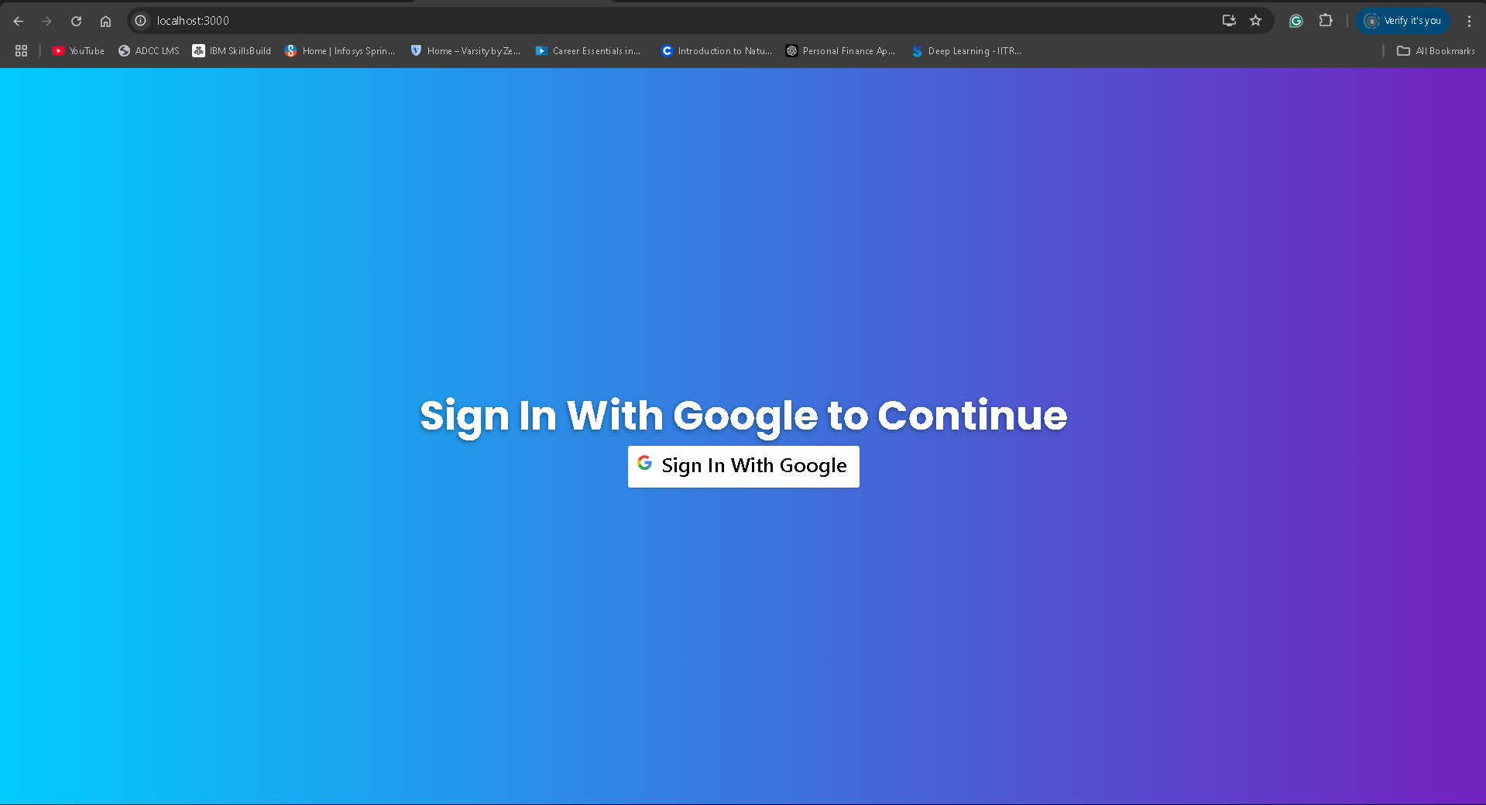
Output

Slide 21
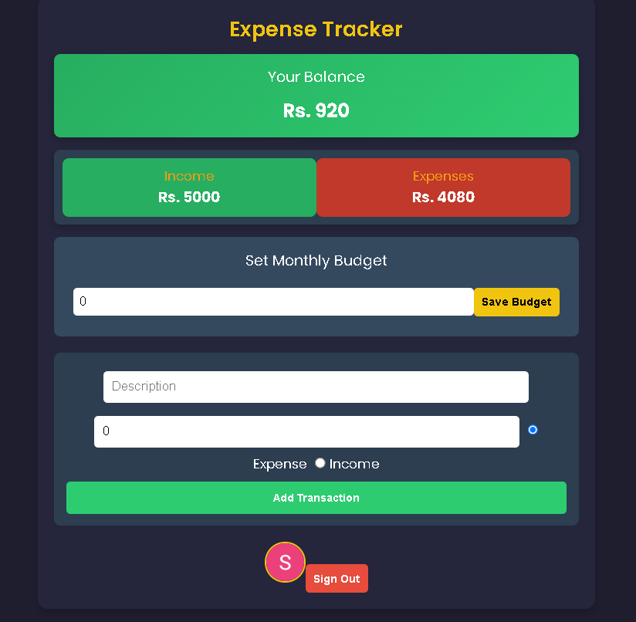
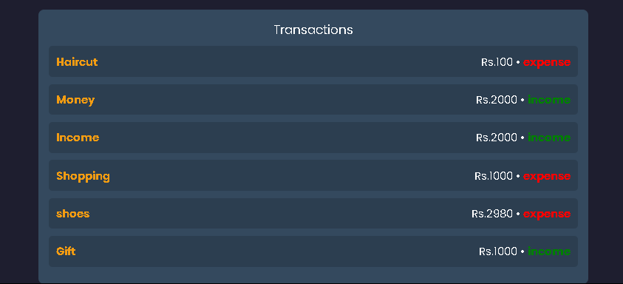
Output

Slide 22
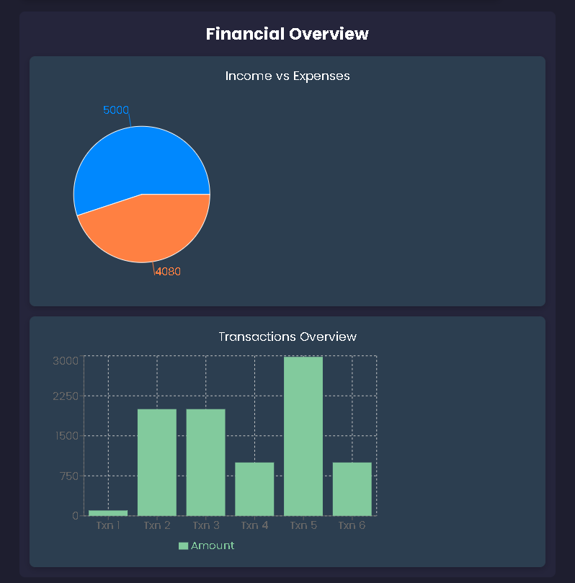
Output

Slide 23
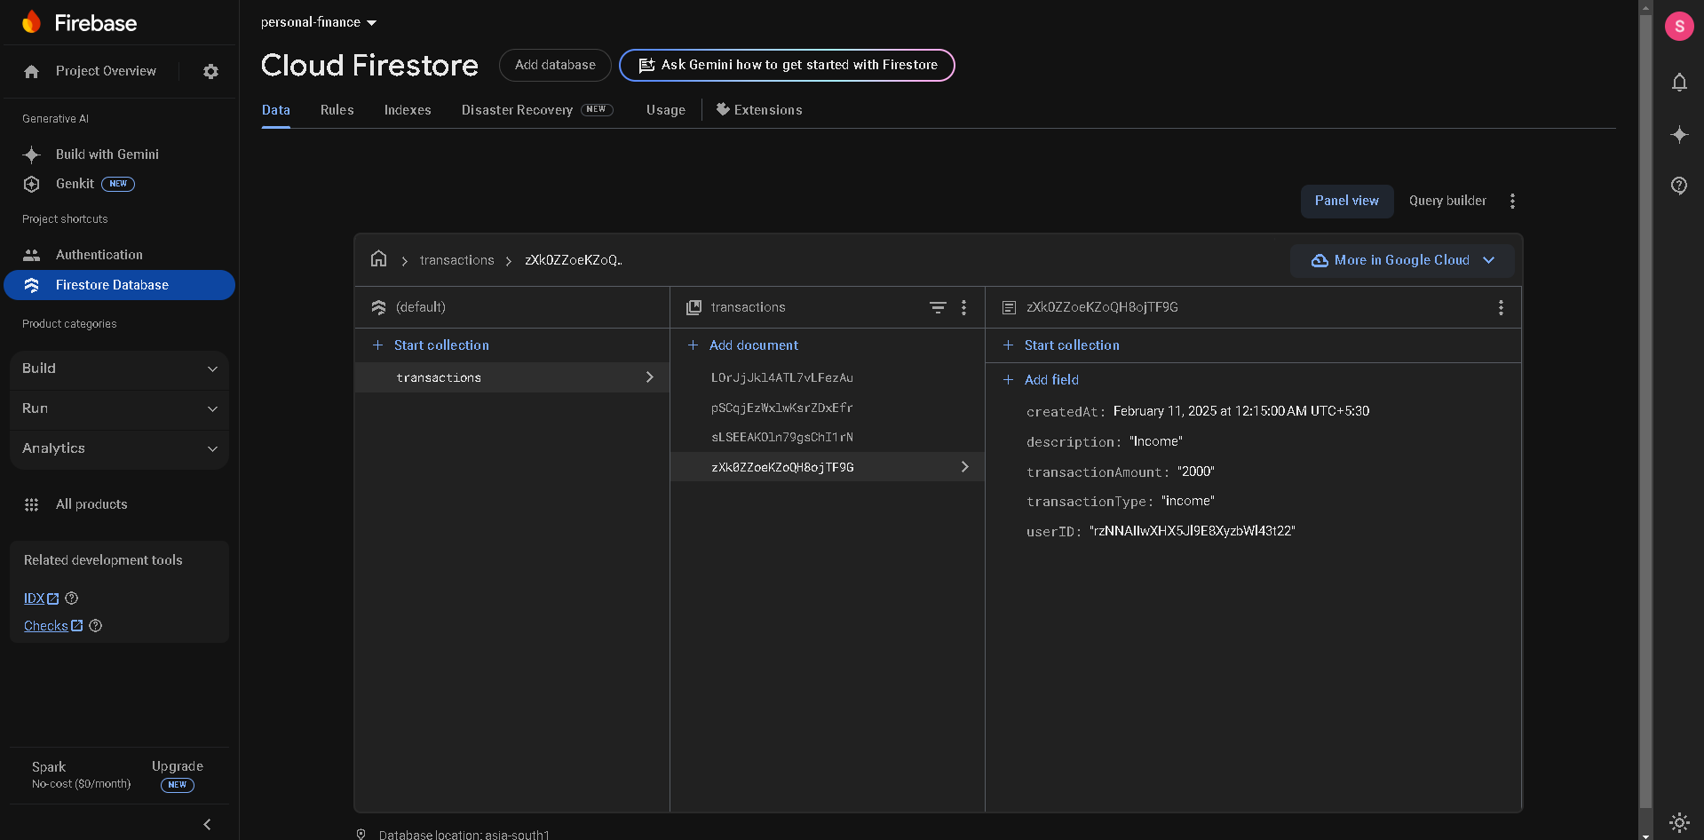
Output

Slide 24
PUBLICATION PLAN
Sr. No. | Target | Month and Year
1 | Publication (Review Paper) in Scopus/SCI Journal
2 | Publication of Research Paper in IEEE Transaction/SCI/ SCOPUS Index Journal (One in each year)
3 | Presentation and Publication in Reputed IEEE/AIP /Web of Science Conferences (One in Each Quarter)
4 | Patent 01 if required
5 | Copyright at least 01
6 | External Funding Project at least 01

Slide 25
SUMMARY
S no | Point | Compliance
1 | Is research gap identified? | Yes
2 | Is the research question is in tune with research gap? | Yes
3 | Is the hypothesis in tune with the research question? | Yes
4 | Is the study design commensurate with the research question? | Yes
5 | Is the study feasible ? | Yes
6 | Whether the research lead to generation of new knowledge or achieve higher level of evidence? | Yes

Slide 26
REFERENCES
Agarwal, Visesh, Ravi Ray, and Nisha Varghese. "An AI-Powered Personal Finance Assistant: Enhancing Financial Literacy and Management.“
Mathursan Balathas, Sabesan Ganeshalingam, Arosh Segar, Yahdhursheika Vallaven, and Samanthi Siriwardana. Money empire: Intelligent assistant for personal finance management.
Longbing Cao. Ai in finance: challenges, techniques, and opportunities. ACM Computing Surveys (CSUR), 55(3):1–38, 2022.
Lewis, Makayla, and Mark Perry. "Follow the money: Managing personal finance digitally." In Proceedings of the 2019 CHI Conference on Human Factors in Computing Systems, pp. 1-14. 2019.
Yogasnumurti, Raras Risia, Isfenti Sadalia, and Nisrul Irawati. "The effect of financial, attitude, and financial knowledge on the personal finance management of college collage students." In Proceedings of the 2nd Economics and Business International Conference-EBIC, pp. 649-657. 2021.
Antoniuk, Dmytro S., Tetiana A. Vakaliuk, Vladyskav V. Didkivskyi, Oleksandr Vizghalov, Oksana V. Oliinyk, and Valentyn M. Yanchuk. "Using a business simulator with elements of machine learning to develop personal finance management skills." In CoSinE@ ICTERI, pp. 59-70. 2021.

Slide 27
THANK YOU

